Slide 1
Innovations in management of cardiac disease: drugs, treatment strategies and technology
R2 ยุพาพร เพ็ชรคงทอง
อาจารย์ ณัฐธพงษ์ ภูวโชติโรจนโภคิน

Slide 3
Outline
Background
Arterial hypertension
Coronary revascularization
Heart failure
Biomarkers
Technological advances

Slide 4
Background
Over the past 25yr there have been innumerable innovations in the management of cardiac disease.
Impacted on the perioperative management of surgical patients.
A selection was chosen for highlighting those most likely to influence clinical practice for adult patients, and particularly elderly patients.

Slide 5
Arterial hypertension

Slide 6
Changing medication over 25yr
25 yr ago treatment of hypertension was recommended in patients
blood pressures above 160/100 mmHg
a target of less than 140/90 mmHg.
1st -line antihypertensive agents were beta-blockers and diuretics.
Maintain all antihypertensive agents up until the day of surgery to avoid the risk of rebound hypertension.

Slide 7
Changing medication over 25yr
Evidence from the Anglo-Scandinavian cardiac outcome trial, in 2005
randomized controlled trial (RCT) with 19,257 patients
beta-blocker was effective in controlling blood pressure but was inferior to a CCB in preventing the long-term damage to target organs.
CCB and ACE inhibitors became first-line treatment
Prevention of cardiovascular events with an antihypertensive regimen of amlodipine adding perindopril as required versus atenolol adding bendroﬂumethiazide as required, in the Anglo-Scandinavian Cardiac Outcomes Trial-Blood Pressure Lowering Arm (ASCOT-BPLA): a multicentre randomised controlled trial. Lancet2005;366:895–90

Slide 8
Changing medication over 25yr
Data from the VISION study (Vascular events In noncardiac Surgery patients cOhort evaluatioN)
withholding ACE inhibitors or ARAs for 24h before non-cardiac surgery
decreased 30-day adverse cardiac events
decreased perioperative hypotension
Recent guidelines suggested that stopping ACE inhibitors and ARAs the day before surgery should be considered because of the risk of perioperative hypotension
Withholding versus continuing angiotensin-converting enzyme inhibitors or angiotensin II receptor blockers before noncardiac surgery: an analysis of the vascular events in noncardiac surgery patients cohort evaluation prospective cohort.Anesthesiology 2017;126:16–27

Slide 9
Evolution of target blood pressures
More recently, the target blood pressure for antihypertensive medication was less than 140/90mm Hg.
Recent guidelines have suggested
less than 150/ 90mm Hg in patients over the age of 60yr
less than 160/90mm Hg in those over the age of 80yr

Slide 10
Evolution of target blood pressures
The SPRINT Trial (Systolic Blood Pressure Intervention Trial) in 2015
reducing BP to 140 mmHg systolic was not best management.
systolic BP less than 120 mmHg showed reduced morbidity and mortality.
A systematic review of target blood pressures (2016)
more than 600,000 patients
systolic BP less than 130mm Hg is beneficial.
A randomized trial of intensive versus standard blood-pressure control.NEnglJMed2015;373:2103–16
Blood pressure lowering for prevention of cardiovascular disease and death: a systematic review and meta-analysis.Lancet2016;387:957–67

Slide 11
Evolution of target blood pressures
In order to achieve target, triple or quadruple antihypertensive therapy is likely to be needed include an ACE inhibitor or a ARA.
Likely to increase the risk of perioperative hypotension.
Recent evidence shows that pre- and perioperative hypotension is a major risk factor for perioperative cardiovascular complications.

Slide 12
Evolution of target blood pressures
Large study with more than 250,000 surgical patients
below a systolic pressure of 119 mmHg , 30-day mortality starts to increase in the elderly.
no clear limit above which systolic blood pressure increases the mortality.
“perioperative blood pressure
what is too high, too low, or just right?”
Venkatesan S, MylesP, ManningHJ, etal .Cohort study evaluating preoperative blood pressure values and risk of 30day mortality following elective non-cardiac surgery. Br J Anaesth2017;119:65–7

Slide 13
Evolution of target blood pressures
study in 22,000 patients with known coronary artery disease
lowering BP below 120 mmHg systolic and 70 mmHg diastolic was harmful over a 5 yr period.
Vidal-Petiot E, Ford I, Greenlaw N, et al. Cardiovascular event rates and mortality according to achieved systolic and diastolic blood pressure in patients with stable coronary artery disease: an international cohort study. Lancet 2016;388:2142–52

Slide 14
Evolution of target blood pressures
When treatment was ineffective, hypertension was a significant risk factor for perioperative adverse cardiovascular events.
When improved treatment, hypertension ceased to be considered a significant risk factor.
More intensive management, hypertension become an important risk factor because of drug-induced perioperative hypotension.

Slide 15
ACC/AHA 2017
Recommendations for BP Treatment
Use of BP-lowering medications is recommended for secondary prevention of recurrent CVD events in patients with clinical CVD and an average SBP of 130 mmHg or higher or an average DBP of 80 mm Hg or higher (I)
for primary prevention in adults with an estimated 10-year atherosclerotic cardiovascular disease (ASCVD) risk of 10% or higher and an average SBP 130 mmHg or higher or an average DBP 80 mm Hg or higher (I)
2017 ACC/AHA Guideline for the Prevention, Detection, Evaluation, and Management of High Blood Pressure in Adults

Slide 16
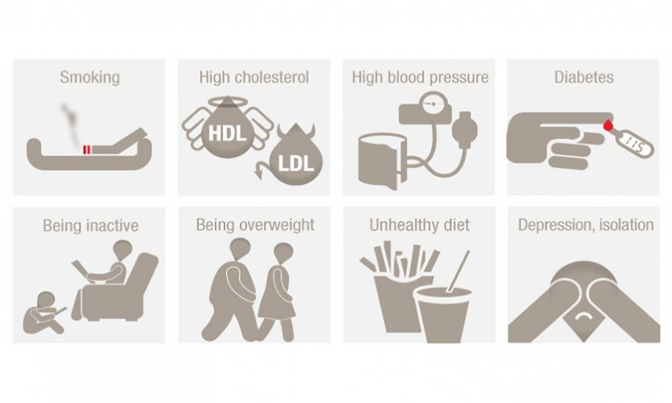
ACC/AHA 2017
Recommendations for BP Treatment
Use of BP-lowering medication is recommended for primary prevention of CVD in adults with no history of CVD and with an estimated 10-year ASCVD risk <10% and an SBP of 140 mm Hg or higher or a DBP of 90 mm Hg or higher (I)
2017 ACC/AHA Guideline for the Prevention, Detection, Evaluation, and Management of High Blood Pressure in Adults

Slide 17
ACC/AHA 2017
Recommendations for BP Goal for Patients With Hypertension
For adults with confirmed hypertension and known CVD or 10-year ASCVD event risk of 10% or higher, a BP target of less than 130/80 mm Hg is recommended (I)
For adults with confirmed hypertension, without additional markers of increased CVD risk, a BP target of less than 130/80 mm Hg may be reasonable (IIb)
2017 ACC/AHA Guideline for the Prevention, Detection, Evaluation, and Management of High Blood Pressure in Adults

Slide 18
ACC/AHA 2017
Recommendation for Choice of Initial Medication
For initiation of antihypertensive drug therapy, first-line agents include thiazide diuretics, CCBs, and ACE inhibitors or ARBs (I)
2017 ACC/AHA Guideline for the Prevention, Detection, Evaluation, and Management of High Blood Pressure in Adults

Slide 19
ACC/AHA 2017
Recommendations for Treatment of Hypertension in Patients With Stable Ischemic Heart Disease (SIHD)
In adults with SIHD and hypertension, a BP target of less than 130/80 mm Hg is recommended (I)
Adults with SIHD and hypertension (BP ≥130/80 mm Hg) should be treated with medications (beta blockers, ACE inhibitors, or ARBs) for compelling indications (previous MI, stable angina) as first-line therapy (I)
2017 ACC/AHA Guideline for the Prevention, Detection, Evaluation, and Management of High Blood Pressure in Adults

Slide 20
ACC/AHA 2017
Recommendations for Treatment of Hypertension in Patients With Stable Ischemic Heart Disease (SIHD)
with the addition of other drugs (e.g., dihydropyridine CCBs, thiazide diuretics) as needed to further control hypertension. (I)
In adults with SIHD with angina and persistent uncontrolled hypertension, the addition of dihydropyridine CCBs , beta blockers is recommended. (I)
2017 ACC/AHA Guideline for the Prevention, Detection, Evaluation, and Management of High Blood Pressure in Adults

Slide 21
ACC/AHA 2017
Recommendations for Treatment of Hypertension in Patients With Stable Ischemic Heart Disease (SIHD)
In adults who have had a MI or acute coronary syndrome, it is reasonable to continue beta blockers beyond 3 years as long-term therapy for hypertension (IIa)
Beta blockers and/or CCBs might be considered to control hypertension in patients with CAD (without HFrEF) who had an MI more than 3 years ago and have angina. (IIb)
2017 ACC/AHA Guideline for the Prevention, Detection, Evaluation, and Management of High Blood Pressure in Adults

Slide 22
New concepts in the pathophysiology of hypertension
Treatment of hypertension could be affected by new findings suggesting that the pathophysiology of hypertension.
changes in the activity of neuronal nitric oxide synthase (nNO synthase).
A small study has shown that inhibition of nNO synthase in healthy human subjects increases arterial blood pressure.
Shabeeh H, Khan S, Jiang B, et al. Blood pressure in healthy humans is regulated by neuronal NO synthase. Hypertension 2017;69:970–6

Slide 23
New concepts in the pathophysiology of hypertension
It may development of new pharmacological agents capable of stimulating nNO synthase.
Shabeeh H, Khan S, Jiang B, et al. Blood pressure in healthy humans is regulated by neuronal NO synthase. Hypertension 2017;69:970–6

Slide 24
Coronary revascularization

Slide 25
The rise of percutaneous coronary interventions
In 1992, in the UK
20,000 patients underwent surgical coronary revascularization
10,000 underwent percutaneous coronary angioplasty
In 1997
surgical and interventional coronary revascularizations were equal.
The 2015 British Cardiovascular Intervention Society(BCIS)
16,500 surgical and 97,000 interventional coronary revascularizations were performed

Slide 26
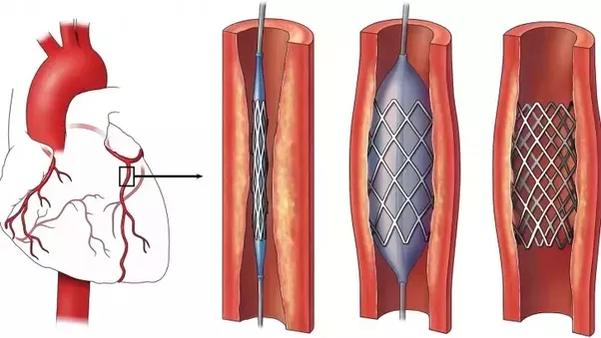
The rise of percutaneous coronary interventions
Managing dual antiplatelet therapy (DAPT) in surgical patients.
Stent thrombosis if DAPT is stopped.
Excessive bleeding if it is maintained must be carefully evaluated.
Risk involved in delaying non-cardiac surgery.

Slide 27
The rise of percutaneous coronary interventions
The recommendation is, to delay non-cardiac surgery until DAPT is no longer needed.
12 months after acute coronary syndromes irrespective of the type of stent
probably 6 months for stable angina for DES
4 weeks for BMS
2016 ACC/AHA Guideline focused update on duration of dual antiplatelet therapy in patients with coronary artery disease: a report of the American College of Cardiology/American Heart Association Task Force on Clinical Practice Guidelines. J Am Coll Cardiol 2016;68:1082–115

Slide 29
Non-cardiac surgery inpatients with coronary stents
The delay between insertion of stents and non-cardiac surgery.
For BMS, more than 30 days is recommended before non-cardiac surgery
For DES, more than 3 months is recommended before surgery is to be considered, preferably waiting for 6 months before proceeding.

Slide 30
After an acute coronary syndrome?
Does the algorithm apply to these patients?

Slide 31
Non-cardiac surgery in patients with coronary stents
With 2nd and 3rd generation DES, recent studies suggest
risk is already reduced 3 months after stent insertion.
It is safe to proceed with non-cardiac surgery 6 months, and if necessary, even 3 months after DES insertion.
Safety of neuraxial blockade in patients receiving antiplatelet??
neuraxial blockade should not be used in the presence of ongoing antiplatelet therapy

Slide 32
Do coronary stents protect against cardiac complications of non-cardiac surgery?
While the 2014 ESC/ESA guideline states that patients with coronary stents remain at higher risk.
The study by Egholm and colleagues, in 2016
4,303 stented patients were matched with 22,232 controls
risk of 30-day MI in patients with DES inserted within 1 yr of surgery was higher than patients without coronary artery disease only for the first 2 months after stent insertion
Insertion of coronary stents may protect against perioperative major adverse cardiac events.

Slide 33
Do coronary stents protect against cardiac complications of non-cardiac surgery?
Generally recommended to maintain DAPT or at least aspirin whenever possible, but studies show the risk of adverse events to be the same whether DAPT is stopped or maintained.
The study in over 1082 patients who underwent cardiac and non-cardiac surgery after insertion of stents
antiplatelet discontinuation increases the 30-day risk of major cardiovascular adverse events (MACE), while not protection from major bleeding.
Antiplatelet therapy and outcome in patients undergoing surgery following coronary stenting: results of the surgery after stenting registry. Catheter Cardiovasc Interv 2017;89:E13–25

Slide 34
Do coronary stents protect against cardiac complications of non-cardiac surgery?
a small study of 201 subjects in 2016
incidence of MACE is high in patients undergoing non-cardiac surgery after previous PCI in spite of adequate perioperative antiplatelet therapy
The 2016 ACC/AHA guideline reiterates that “decisions are best determined by a consensus of the surgeon, anesthesiologist, cardiologist, and patient”.

Slide 35
Surgery in patients with previous myocardial infarction
Management of patients presenting later for non-cardiac surgery after myocardial infarction
Sufficient time needed to have elapsed before elective non-cardiac surgery.
The delay was reduced from six to three months.
Or even six weeks if there was no ischemia on a stress test.
Recent studies show that patients are at very high risk for postoperative cardiac complications if operated on less than 3 months after receiving stents for MI

Slide 36
Surgery in patients with previous myocardial infarction
In the longer term, there may be a decrease in the number of patients suffering acute myocardial infarction.
Plaque rupture is a major cause of acute coronary events.
Smooth muscle constitutes part of the interface between the thrombogenic core of atheroma and the lumen of the vessel.
Therapies aimed at reducing apoptosis of smooth muscle.

Slide 37
Heart failure

Slide 38
Pharmacological advances in the treatment of heart failure
In the surgical setting, heart failure is the worst risk factor for adverse perioperative cardiac events.
In the past, medical treatment has progressed with use
ACE inhibitors
beta-blockers
more recently aldosterone antagonists
digoxin is given only atrial fibrillation

Slide 39
Pharmacological advances in the treatment of heart failure
Innovations have included a brain natriuretic peptide (BNP) analogue (nesiritide) and Ivabradine.
Ivabradine
blocker of the ‘funny’ channels in pacemaker cells
spontaneous depolarization of the cells becomes slower
heart rate decreases.

Slide 40
Pharmacological advances in the treatment of heart failure
More recently, sacubitril/valsartan has been introduced.
Sacubitril is a blocker of neprilysin (enzyme that degrades both atrial and brain natriuretic peptides)
contribute to improving cardiac function
reinforced by the afterload-reducing properties of the ARA valsartan

Slide 41
Pharmacological advances in the treatment of heart failure
National Institute for Health and Care Excellence (NICE) recommend ivabradine and sacubitril/valsartan
patients on optimal heart failure medication and with an ejection fraction of less than 35%.

Slide 42
Resynchronization therapy
Dyssynchrony of ventricular contraction decreases its pumping efficiency.
The use of cardiac resynchronization devices.(cardioverter-defibrillator and/or a cardiac pacemaker)
Improve the survival of patients with heart failure from sudden and unexpected death (electrical disturbances in their myocardium)

Slide 43
Resynchronization therapy
These devices are recommended only in patients with an ejection fraction less than 35%.

Slide 44
Challenges for the future
There is still a large number of patients who have advanced heart failure with poor prognosis despite optimal medical therapy.
Because improved management of acute myocardial infarction has reduced its early mortality.
People survive the initial episode but suffer from significant cardiac dysfunction

Slide 45
Challenges for the future
Mechanical assistance of the heart started with the intra-aortic balloon pump almost 60 yr ago.
Development of ventricular assist devices and progress has been made with left ventricular assist devices.
Mechanical assistance of the heart is still associated with some disability in the form of lifestyle limitations.

Slide 46
Challenges for the future
Cellular repair of the myocardium is becoming an important area for research.
introduction of techniques for inserting bone marrow cells into the damaged myocardium and promoting vessel growth.
development of small molecules that ‘direct’ the development of stem cells into myocytes.
Offer hope to patients that is refractory to conventional medical treatment and in whom coronary revascularization cannot be considered.

Slide 47
Biomarkers

Slide 48
Detection of silent myocardial damage and implications: the concept of myocardial injury in non-cardiac surgery (MINS)
For many years there was considerable interest in perioperative silent myocardial ischemia as recorded by ECG monitors.
Silent ischemia association with peri- and postoperative adverse cardiovascular events is variable.
Cardiac biomarkers such as troponins show a strong association between elevated levels and adverse outcome.

Slide 49
Detection of silent myocardial damage and implications: the concept of myocardial injury in non-cardiac surgery (MINS)
The VISION study, with over 15,000 patients showed
increases in troponin T (TnT) to be consistently associated with postoperative mortality.
elevations of TnT indicate the presence of myocardial injury.
MINS is characterized by TnT above 0.03ng /litre
elevation is not associated with clinical signs of myocardial ischemia.
injury would be unrecognized in the absence of routine troponin assays.

Slide 50
Detection of silent myocardial damage and implications: the concept of myocardial injury in non-cardiac surgery (MINS)
High-sensitivity TnT (hs-TnT) levels confirmed the prognostic role of elevated troponins with a mortality.
9.1% for hs-TnT between 65 and 1000 ng/litre and 29.6% for hs-TnT above 1000 ng/litre.
Elevations of troponin I (TnI) after major non-cardiac surgery are associated with increase in postoperative death, especially within the first 6 months after surgery.

Slide 51
Monitoring troponins and managing their rise
2014 guidelines suggested that postoperative troponin assays may be useful in very high-risk patients.
2017 Canadian guideline recommends to obtain daily troponin measurements for 48–72h after non-cardiac surgery in patients with baseline risk of more than 5% for cardiac death.

Slide 52
Monitoring troponins and managing their rise
Strategy for the management of patients with MINS.
Studies show that many of the patients who develop MINS suffer from cardiovascular disease but are not on optimal therapy
First approach is to optimize their treatment.

Slide 53
Monitoring troponins and managing their rise
Strategy for the management of patients with MINS.
Achieved by adding agents, or increasing the dosage of the appropriate medications.
beta-blockers, statins, ACE inhibitors and an antiplatelet agent (often aspirin)

Slide 54
Monitoring troponins and managing their rise
The effectiveness of this approach has been demonstrated in a small study: it decreased the risk of adverse events.
As the role of MINS is better recognized this will stimulate research in novel therapies that may include coronary revascularization.

Slide 55
BNP and N-terminal prohormone of brain natriuretic peptide (NT-proBNP)
BNP and NT-proBNP are released from the myocardium
mechanical, chemical, hemodynamic, humoral, ischemic and inflammatory inputs.
used as markers of heart failure.
elevated BNP or NT-proBNP are very useful markers of cardiac dysfunction and correlate with adverse outcome.
Elevated B-type natriuretic peptide predicts 30-day and over 6 month outcome in non-cardiac surgery.

Slide 56
BNP and N-terminal prohormone of brain natriuretic peptide (NT-proBNP)
Pre - and postoperative monitoring of BNP or NT-proBNP may help to identify patients at very high risk and facilitate their pharmacological management.
The field of biomarkers is expanding, elevation of presepsin is associated with increased 30-day, 6months and 2yr mortality in cardiac surgery patients

Slide 57
Technological advances

Slide 58
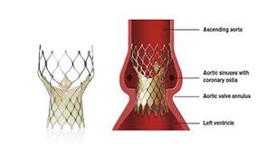
Transcatheter aortic valve implantation (TAVI)

Slide 59
Transcatheter aortic valve implantation (TAVI)
The introduction of TAVI has not changed the indications but offer to patients in whom the risks of surgical repair would be too high.
2017 NICE guideline states that
TAVI offers a potential treatment for patients with aortic stenosis for whom surgical aortic valve replacement would not be suitable

Slide 60
Transcatheter aortic valve implantation (TAVI)
The number of TAVI has grown from 66 in 2007 to 2473 in 2015.
Mean age of patients was 81 yr.
30-day mortality has decreased from nearly 14% in 2007 to less than 4% in 2012.
Reduce the number of patients with significant uncorrected aortic stenosis presenting for non-cardiac surgery.

Slide 61
Transcatheter aortic valve implantation (TAVI)
Many types of valves have been developed. (self inflating ,balloon inflated)
The procedure is carried out under local anesthesia with or without some additional sedation.
Femoral and subclavian arteries are used for their insertion.

Slide 62
Transcatheter aortic valve implantation (TAVI)

Slide 63
Transcatheter mitral valve replacement (TMVR)

Slide 64
Transcatheter mitral valve replacement (TMVR)
TMVR may be an option for selected patients with severe mitral regurgitation.
This intervention may help address an unmet need in patients at high risk for non-cardiac surgery.
Progress has been slow in the UK as 3 implantations were performed in 2008 and still only 86 in 2015.

Slide 65
Pharmacogenetics
Most drugs do not cure 100% of the patients they are designed to treat.
The lack of efficacy relates to the genetic make-up of patients.
patients with cytochrome P4502C19 polymorphism as this decreases its antiplatelet activity
beta(1)AR-389 variation alters signalling and affects therapeutic responses to beta-blockers
variants in SLCO1B1 are strongly associated with an increased risk of statin-induced myopathy

Slide 66
Pharmacogenetics
Altered efficacy and patterns of side-effects are likely to play an important role with many drugs.
Advances in pharmacogenetics will make it possible to personalize treatments.

Slide 67
Telemonitoring
Ambulatory monitoring of BP has become tool in diagnosis of arterial hypertension before initiating treatment but it is not yet wireless.
ECG telemonitoring has entered out-of-hospital practice and transmits to a specialist center.
important tool in the diagnosis of myocardial infarction before admission to hospital
detection and management of severe arrhythmias.

Slide 68
Telemonitoring
Many wrist-watch-size BP monitors are under development.
based on the principle of analysing the waveform at the level of the radial artery.
data include systolic and diastolic blood pressures and heart rate.
transmitted via a mobile phone, data can be remotely downloaded.
Devices play an important role in the preoperative assessment of hypertensive patients.

Slide 69
Telemonitoring
The development of easily wearable and reliable ECG, pulse oximetry and blood pressure monitors, with data transmitted wirelessly to a central server
make it possible to monitor mobile patients
institute treatment in good time to prevent adverse outcomes

Slide 70
Cardiac investigations
Cardiac catheterization and coronary angiography are invasive gold standard investigations.
More information is becoming available non-invasively
radionuclide assessment of the coronary circulation
computed tomography (CT) including CT angiography
cardiac magnetic resonance imaging (CMR)

Slide 71
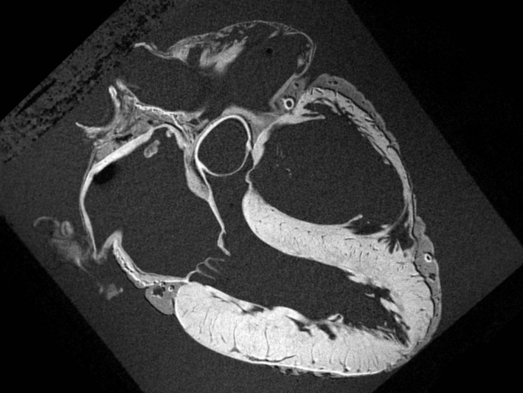
Cardiac investigations
Magnetic resonance imaging (CMR)
basic structure and function can be easily determined.
allows visualization of infarction and assessment of the potential for functional recovery.
also informs on disease etiology.
predicts the risk of heart failure.

Slide 72
Conclusions
In the last 25 yr considerable innovation in the management of cardiac disease, drugs, treatment strategies, and technology has taken place.
What seems to be almost science fiction today may then be daily routine.

Slide 73
Take home message
Arterial hypertension
Recommendation for BP treatment
For patient with clinical CVD : BP 130/80 mmHg
For patient with no history CVD : BP 140/90 mmHg
Recommendation for BP goal for patient with hypertension
For hypertension and known CVD : BP target of less than 130/80 mmHg
For hypertension without CVD : BP target of less than 130/80 mmHg

Slide 74
Take home message
Arterial hypertension
Choice of initial medication : thiazide, diuretics, CCBs, and ACEI or ARB.
Coronary revascularization
Delay non-cardiac surgery until DAPT is no longer needed
12 months after acute coronary syndrome
6 months for stable angina for DES
4 weeks for BMS

Slide 75
Take home message
Heart failure
New pharmacological treatment : Ivabradine, sacubitril/valsartan
Recommended in patients on optimal heart failure medication with EF less than 35%
Resynchronization : recommended in patient with EF less than 35%

Slide 76
Take home message
Biomarkers
Guideline suggest that postoperative troponin assays may be useful in very high-risk patient.
2017 Canadian guideline : daily troponin measurements for 48-72 hr after non cardiac surgery
Pre-postoperative monitoring of BNP or NT-proBNP may help to identify patients at very high risk and facilitate their management.

Slide 77
Take home message
Technological advances
TAVI and TMVR : offer potential treatment for whom surgical replacement would not be suitable
Pharmacogenetics : will make it possible to personalize treatment.

Slide 78
Take home message
Technological advances
Telemonitoring : development of EKG, pulse oximetry and blood pressure monitors, with data transmitted to a central server
Cardiac investigation
Magnetic resonance imaging (CMR) : basic structure and function can be determined.

